Slide 1
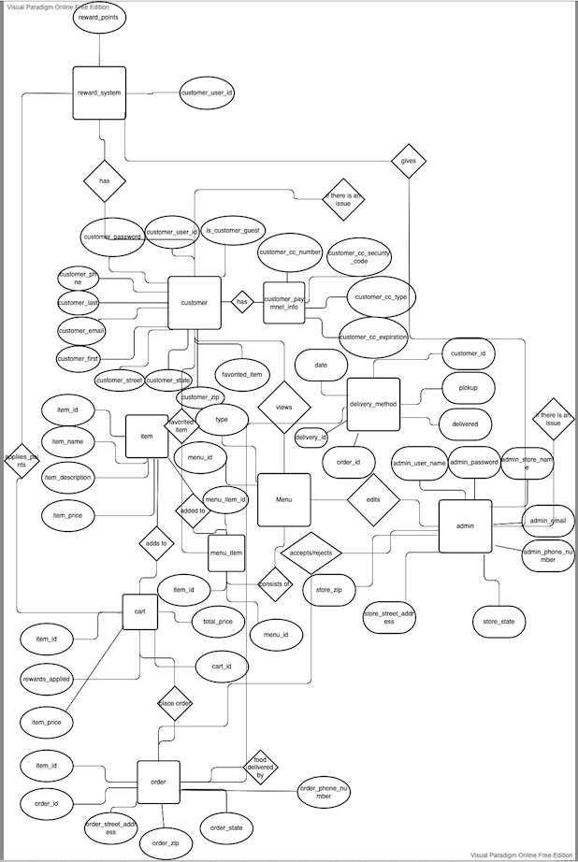
Team 2 Conceptual ER Diagram

Slide 2
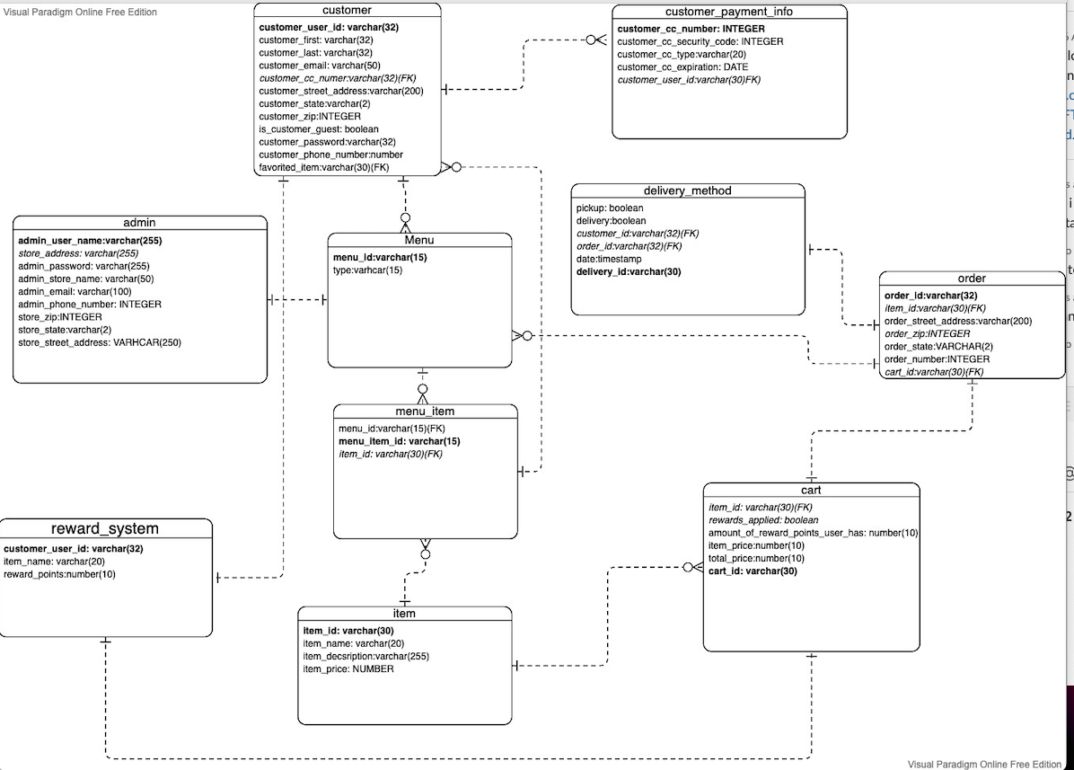
Team 2 Logical ER Diagram

